Slide 1
Мониторинг смертности после строительства: анализ данных
Post-construction fatality monitoring: data analysis
Paul Rabie, PhD
Пол Рэби, PhD
Notes:
Good evening. I want to thank ACBK for hosting this lecture series and for inviting me to speak. And thanks to all of you for taking the time to attend this lecture.
My topic tonight data analysis is a lot to cover in one talk. I’m going to walk you through the analysis of a post-construction fatality monitoring analysis. You will hear me say “PCFM” to abbreviate post-construction fatality monitoring during this talk. Before we get into analysis, I’m going to mention a couple resources that you should definitely be aware of, and then give an overview of what the data look like.
Keep in mind that the supplementary material I provided for this lecture includes two different example analyses for you to refer to, so you can work through those, too, if that’s helpful.

Slide 2
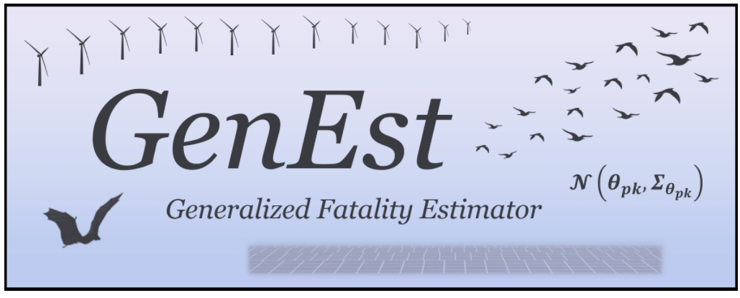
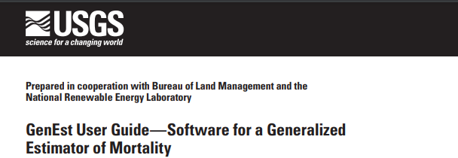

GenEst SOFTWARE ПРОГРАММНОЕ ОБЕСПЕЧЕНИЕ GenEst
State of the art post-construction fatality monitoring (PCFM) data analysis tool
Freely available
  On your computer (requires R software—also free)
  Or at https://connect.west-inc.com/GenEst/
Современный инструмент анализа данных мониторинга смертности после строительства (PCFM)
В свободном доступе
  На вашем компьютере (требуется программное обеспечение R - также бесплатное)
  Либо на https://connect.west-inc.com/GenEst/
Notes:
GenEst is the software we use to analyze post construction fatality monitoring data. It is state of the art and was developed by an international team of statistical experts. It runs on the R statistical computing software, and both software packages are freely available. If you don’t want to, or cannot install the software on your computer, WEST hosts a free online version that you can use, too. There are instructions for how to obtain and install the software in the reading materials I provided for this talk. The GenEst user manual also includes a worked analysis example.

Slide 3

GOOD PRACTICE HANDBOOK РУКОВОДСТВО ПО ПЕРЕДОВОЙ ПРАКТИКЕ
Post-construction fatality monitoring (PCFM) concepts and principles
PCFM study design Decision Support Tool
Practical guidance for field work (with template data sheets)
GenEst analysis worked example
Концепции и принципы мониторинга смертности после строительства (PCFM)
Дизайн исследования PCFM, Инструмент поддержки принятия решений
Практическое руководство по проведению полевых работ (с шаблонами форм для заполнения)
Пример практического анализа GenEst
  https://www.ifc.org/en/insights-reports/2023/bird-bat-fatality-monitoring-onshore-wind-energy-facilities
Notes:
The Good Practice Handbook for post-construction fatality monitoring in emerging markets is an absolutely fantastic resource. It was financed by an international consortium of lenders and developed by an international group of consultants, with input from stakeholders, and subject-matter experts. It is purpose-built to guide PCFM in emerging markets. The IFC spearheaded this effort, and they intend this book to define monitoring expectations in emerging markets going forward, so it’s an important tool to be aware of. The reading materials I provided for this lecture include the web link where you can download this resource.
The handbook covers concepts and principles of PCFM design, and includes a decision support tool that will help you design a monitoring study for your project. It includes practical advice for how to complete the field work, and even has template data sheets you can use to collect data. Finally, it includes a worked analysis example using GenEst.

Slide 4
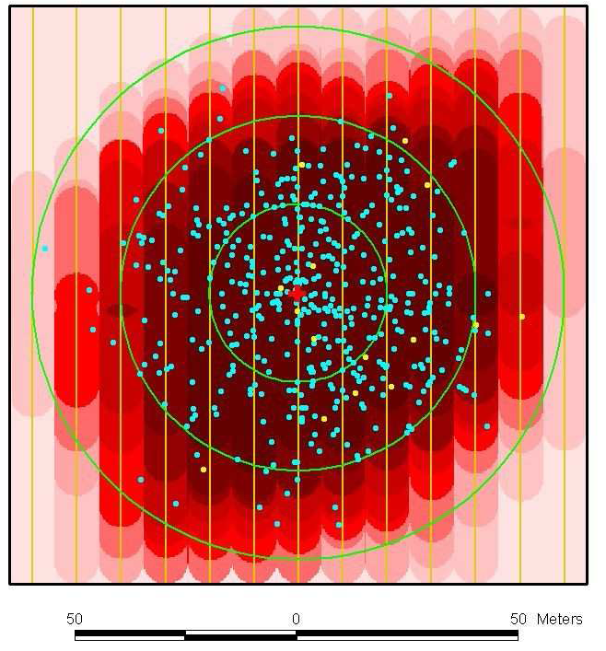
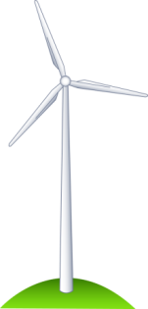
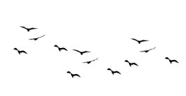
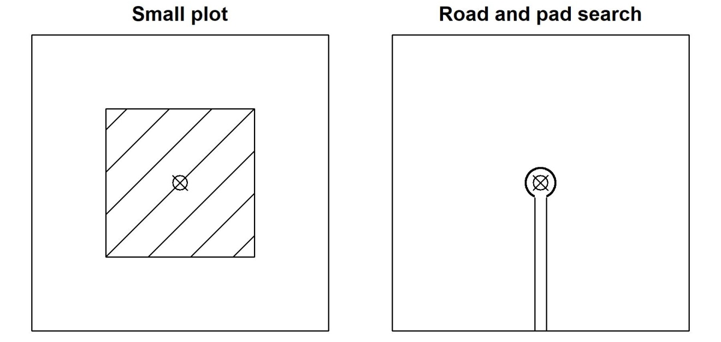
PCFM STUDY OVERVIEW ОБЗОР ИССЛЕДОВАНИЯ PCFM
1. Fatalities occur at turbines
2. Some carcasses fall within searchable areas
1. Смертельные случаи происходят на турбинах
2. Некоторые трупы попадают в зоны поиска
Notes:
As we think about the data analysis to produce a fatality estimate, it will be helpful to keep in mind how the data are generated. The objective here is to estimate the number of birds or bats that are killed at a wind farm, over a specific period of time. And do to that, we send searchers out into the wind farm to count dead things. But those raw counts always under-represent the number of dead because of some biases that are inherent in the data-generating process. These next few slides illustrate the reasons that a simple count of carcasses is always an underestimate of the number of fatalities that occurred. Our data analysis will attempt to adjust the carcass count for these sources of bias.
To the data generating process: as shown in the little cartoon on the left, first, there are collisions and fatalities that occur at turbines.
Now, these carcasses do not fall uniformly around turbines. The figure on the top right shows the turbine as the red dot in the center, and all of the little blue dots are carcass locations. You can see that most carcasses fall close to the turbine, and fewer fall further away. Some will fall outside of searched areas. So in the two figures on the bottom, I’ve shown a small search plot on the left as the hatched square, and you can see that most of the carcasses fall within it. On the right is a plot that is confined to the turbine pad and access road, and in that case, most of the carcasses will fall where we are not going to search. This is the first source of bias to affect our carcass counts, and to adjust it we estimate the fraction of carcasses that fall within the search plots. This is called the density weighted proportion of area searched

Slide 5
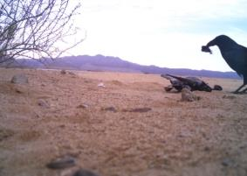
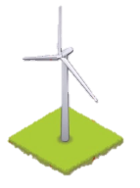
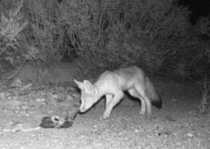
PCFM STUDY OVERVIEW ОБЗОР ИССЛЕДОВАНИЯ PCFM
3. Some carcasses are scavenged (or removed by other means)
4. Sample of Facility is searched
4. Пример поиска на объектах
3. Некоторые трупы изымаются падальщики (или другими способами)
Notes:
Third, there is the carcass removal process. We don’t have searchers on the ground at all times. They visit the turbines perhaps once or twice a week, and in the interval between when the collisions occur and when a searcher arrives, some of the carcasses will be removed by scavengers. On the left we see a raven and a fox taking carcasses at wind farms. This is the carcass removal bias that affects carcass counts. We use experimental data to estimate the effect of carcass removal on our carcass counts.
Fourth, when we do search for carcasses, we do not usually search the entire wind farm. Rather, we search a sample of the wind farm, shown on the right as turbines with blue plots around them. Obviously, any carcasses occurring at unsearched turbines are not going to be included in our carcass counts.

Slide 6
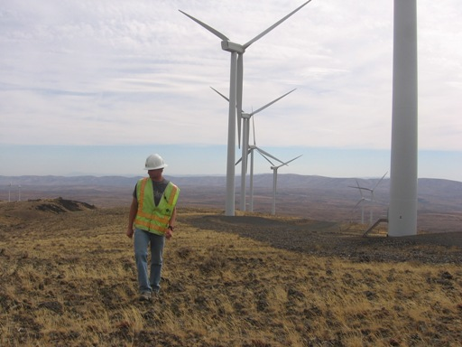
PCFM STUDY OVERVIEW ОБЗОР ИССЛЕДОВАНИЯ PCFM
5. Some fraction of the available carcasses are detected by searchers
5. Некоторая доля трупов обнаруживается учетчиками
Notes:
Fifth, and finally, when the searchers do go out to search, they simply will not see all of the carcasses that are there, so the lack of perfect searcher efficiency is the final bias that we correct fo when estimating fatality at wind farms. We use experimental data to estimate searcher efficiency, too.

Slide 7

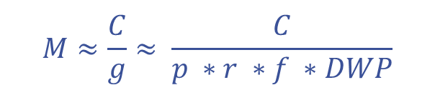
FATALITY ESTIMATION ОЦЕНКА СМЕРТНОСТИ
$$M≈\frac{C}{g}≈ \frac{C}{p ∗r ∗f ∗DWP}$$
$$M≈\frac{C}{g}≈ \frac{C}{p ∗r ∗f ∗DWP}$$
M = estimated number of fatalities
C = the count of carcasses from monitoring
g = overall probability that a carcass arriving at the site will be documented in the data
p = the searcher efficiency
r = the persistence probability
f = sampling fraction
DWP = density weighted proportion of area searched
M = расчетное количество смертей
C = количество трупов, полученных в результате мониторинга
g = общая вероятность того, что упавший труп будет задокументирован
p = эффективность учетчика
r = вероятность сохранности
f = доля выборки
DWP = взвешенная по плотности доля исследованной территории
Notes:
All of the above processes are captured in this one equation. This is a simplified version of the equation used by GenEst to estimate total mortality. The actual equation is much more complicated but this is a decent approximation. M, on the left side, is the estimated total number of fatalities. C is the count of carcasses from monitoring. We divide that by the detection probability (g) to get an estimate. The detection probability is roughly the product of
searcher efficiency, p, which is the probability that a searcher will actually see the carcass, if it is there when they are searching,
the carcass persistence probability, r, which is the probability a carcass will not be scavenged between the moment it arrives and the next scheduled search,
f is the sampling fraction – the number of turbines searched divided by the total number at the facility, and
DWP is the fraction of carcasses that actually fall into a searched area.
The count, C, is a raw data item. The sampling fraction, f, is known from the study design, and the other three components in the denominator are estimated. I will spend the next few slides describing the data used to estimate those components

Slide 8
ANALYSIS STRATA СЛОИ ДЛЯ АНАЛИЗА
Analysis strata
Слои для анализа
Stratum = “type” or “class”
PCFM analysis tracks each stratum in the data.
Common examples of strata
  Carcass size
    Bat
    Small bird
    Medium bird
    Large bird
  Season
    Can affect searcher efficiency
    Can affect carcass persistence
  Plot type & searchability
    Road and pad
    Full plot
      Easy search conditions
      Difficult search conditions
Слой (stratum) = «тип» или «класс»
Анализ PCFM отслеживает каждый слой данных.
Частые примеры слоев
  Размер трупа
    Летучая мышь
    Маленькая птица
    Средняя птица
    Большая птица
  Время года
    Может влиять на эффективность учетчика
    Может влиять на сохранность трупа
  Тип участка и возможность поиска
    Дорога и площадка
    Полный участок
      Легкие условия поиска
      Сложные условия поиска
Notes:
One of the first things to remember is that not all carcasses are the same, and GenEst keeps track of the different kinds of carcasses, because the detection probabilities can be quite different.
Common strata in PCFM designs include carcass size, which can influence searcher efficiency, carcass removal, and the DWP
Data are also often stratified on season, which may impact searcher efficiency if vegetation growth influences the ability of searchers to find carcasses. Carcass scavenging rates also commonly vary with season
Plot types can be an important stratum because searcher efficiency is usually different on a prepared surface such as a turbine pad compared to a vegetated plot. Differenly sized plots also differ in the fraction of carcasses that fall within them.
Importantly, all of the data you collect for a PCFM study needs to keep track of these strata

Slide 9
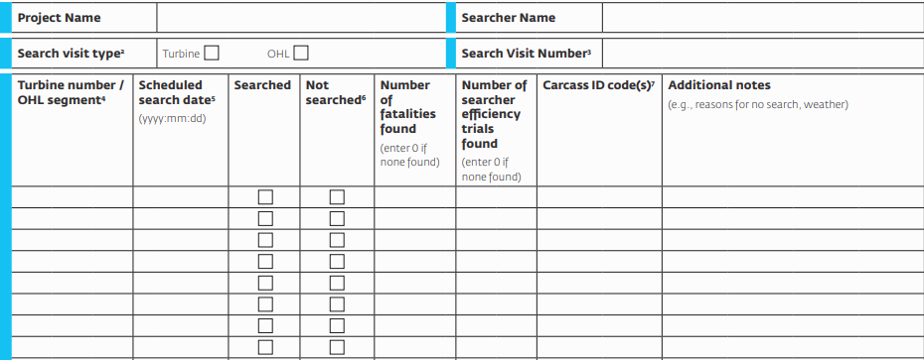
CARCASS SEARCHES ПОИСК ТРУПОВ
Номер турбины
Запланированная дата поиска
Исследована
Не исследована
Notes:
And now to the data. These next few slides show the data form templates from the Good Practice handbook. For these slides I have highlighted the important data fields on the form and they are translated below.
The first and very important form is the search schedule form. We will need to record, for each turbine, the dates on which it was searched. you cannot complete an analysis without these data. The items I’ve highlighted in yellow are used by the GenEst software. The items I’ve highlighted in blue are very helpful when checking the data for errors.
The data from these forms gets entered into a simple matrix with search dates in rows, turbine names in columns, and a 1 or a 0 indicating whether the turbine was searched on each date

Slide 10
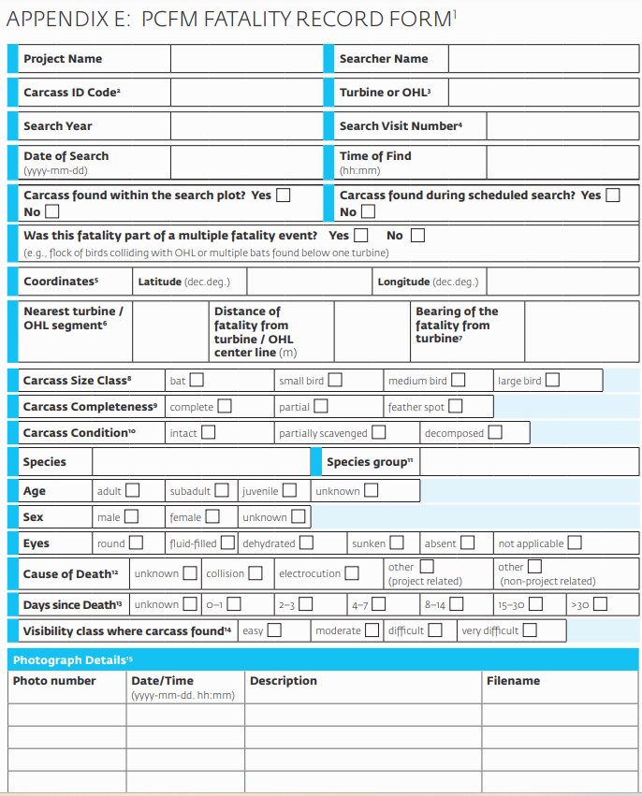
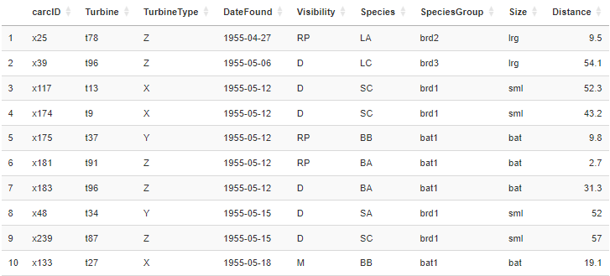






CARCASS OBSERVATIONS МОНИТОРИНГ ТРУПОВ
Carcass searches
Field data
Идентификационный код трупа
Турбина
Дата поиска
Труп обнаружен в пределах участка поиска Расстояние до турбины
Класс размера трупа
Notes:
Every carcass that is found gets its own data sheet, shown on the left. Usually we collect a lot of data on each carcass such as species, age, sex, possible cause of death, and some of that is used in reporting and for other analyses, but for fatality estimation, we need the items I’ve highlighted in yellow: a unique carcass identification number, the turbine and search date when it was found, the size class of the carcass, any of the other stratum identifiers (such as season or plot type), and the distance of the carcass from the turbine. The table on the right shows collected data for ten carcasses, in the format we use for GenEst.
I should note that GenEst is somewhat particular about how data are formatted. Luckily, the software includes example data sets that show exactly how to format it.

Slide 11
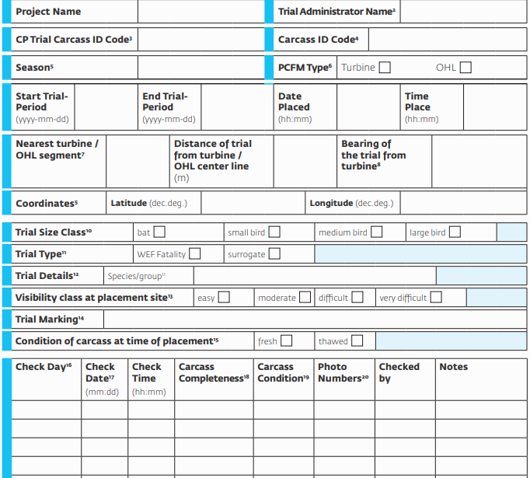
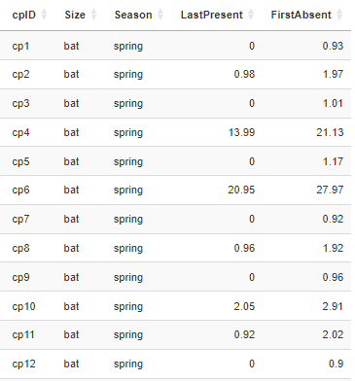
CARCASS PERSISTENCE СОХРАННОСТЬ ТРУПОВ
Apr 12
11:00
Сезон
Апрель
Размерный класс пробного трупа
Присутствует
Изъят
Присутствовал в последний раз
Отсутствовал в последний раз
1
Apr 13
09:00
Intact
Present
2
Apr 14
12:10
Scavenged
Present
3
Apr 15
08:50
Removed
Absent
Notes:
Carcass persistence data are collected experimentally. The process is to drop a series of fresh carcasses around the wind farm and then revisit them to check whether they have been removed. Typically we will drop at least twelve carcasses and check them on days 1, 2, 3, 4, 7, 10, 14, and 21 after we place them. We have to have a set of trial carcasses for each search stratum. That usually means at least 12 per season, but if there are different habitat types or plot types in the wind farm the number of trial carcasses increases.
The information we need from these carcasses is the stratum information: season and size class, when was the last time they were present, and when was the first time we know that they were absent. On the left I’ve shown a data form for a single trial carcass, and on the right, the data summary for twelve trial carcasses. On the data form, I’ve highlighted in yellow that the carcass was placed on April 12 at 11AM. Below, we can see that the carcass persisted about three days. The date in red, April 14 at 12:10PM, is 2.05 days since the carcass was placed, and that is shown in the lastPresent column in the data at right. The date in green, April 15 at 8:50AM is the first date that the carcass was absent, and that is 2.91 days since the carcass was placed

Slide 12
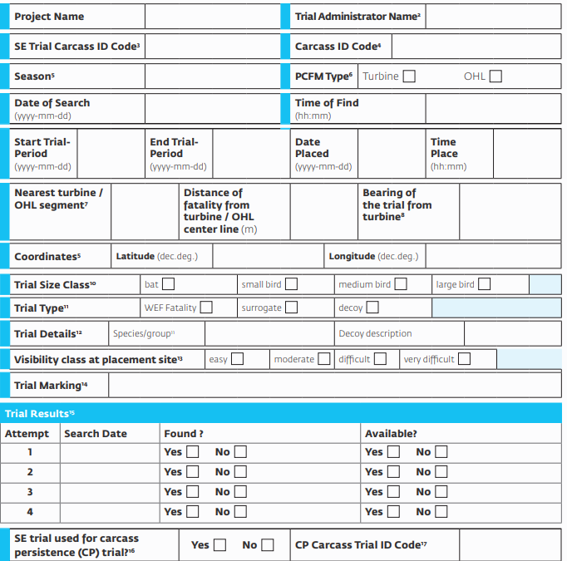
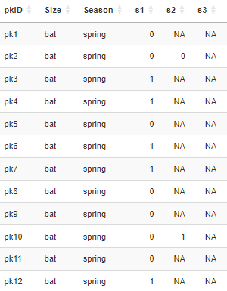
SEARCHER EFFICIENCY ЭФФЕКТИВНОСТЬ УЧЕТЧИКА
Сезон
Размерный класс
пробного трупа
Класс видимости
Попытка
Дата поиска
Найден
Доступен
Notes:
Searcher efficiency data are also collected experimentally. The process is for a trial administrator (who is not a searcher) to sneak out and place marked trial carcasses in search areas before a scheduled search. Searchers are unaware of the timing or locations of trial carcasses, and they report them when they find them. After the carcass search, the administrator checks on the trial carcasses to confirm that each carcass not found by searchers was still available (and not simply removed by a scavenger).
The important data are again the information about the strata that is, the season and trial size class, the search date, whether it was found, and whether it was available to be found. In the data on the right, the trial outcomes (found or not found) are coded as zeroes and ones under the column s1. At the bottom of the form on the left there is a column I’ve highlighted in green that says: “attempt.” This is not something that is used often. It is used when searcher efficiency trials are left in the field for an extended period, and then searchers have more than one chance to find the carcass. Those second and third search results are entered into data under the columns s2 and s3. NA means ‘not applicable’ and indicates that the trial carcass was found on a previous search, or had been removed by a scavenger. Again, this is not something you that is used very often.

Slide 13
FATALITY ESTIMATION ОЦЕНКА СМЕРТНОСТИ
DWP
GenEst cannot estimate DWP
R packages for advanced R users
  windAC
  DWP
Good Practice Handbook Appendix D
GenEst не может оценить DWP
R-пакеты для опытных пользователей R
  windAC
  DWP
Руководство по передовой практике Приложение D
Notes:
We are going to move now to an example data analysis, mostly using GenEst
But unfortunately, one thing GenEst cannot do is estimate the DWP: the fraction of carcasses that actually fall within a searched area. There are several ways to estimate the DWP, including a couple of R packages that I’ve listed on the screen, but the simplest way is to use a tool that is provided with the Good Practice Handbook.

Slide 14
Paul Rabie, PhD
prabie@west-inc.com

